Slide 1
Welcome to the Dynamic List Program
Using Python
Under guidence
Lokesh singh
Prensented by
Rohit Kumre

Slide 2
Introduction
List can hold elements of different types, and you can perform various operations like adding, removing, or checking for the existence of elements. The example above demonstrates some basic list operations, but there are many more you can explore depending on your specific needs.

Slide 3
Purpose of List
Calculation performed on an element
Item extracted from an Iterable
Check condition in element meets
Random Data type Element
Find Element And modifying
It very fast and efficient work
Dynamic Size can grow or shrink in size during runtime
It is Immutable and changeable element

Slide 4
Using Function in list
Different types of Problem solve like in List
Data Insert
Data Remove
Data Exchange
Data Modified
Find Data length
Check Status in Data
Clear all Element in list
Break

Slide 5
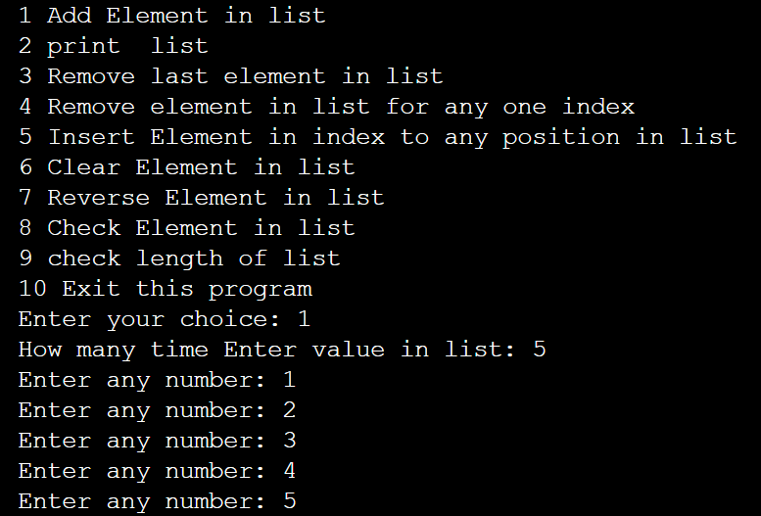
console image

Slide 6
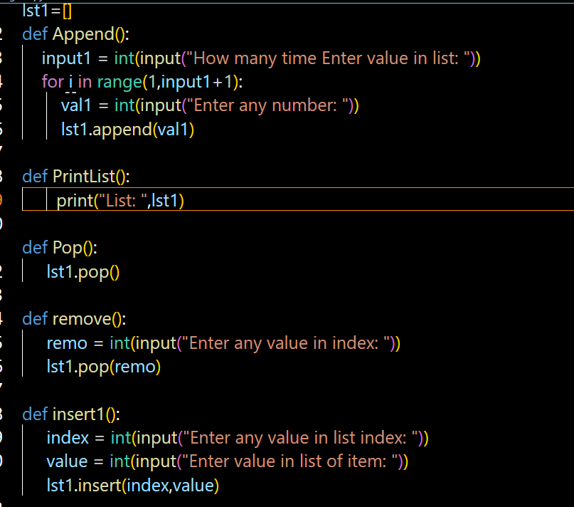
List code

Slide 7

Demo

Slide 8
Required Technology
Python
Code Editor for VS code
Python Interpreter

Slide 9


Slide 10


